Slide 1
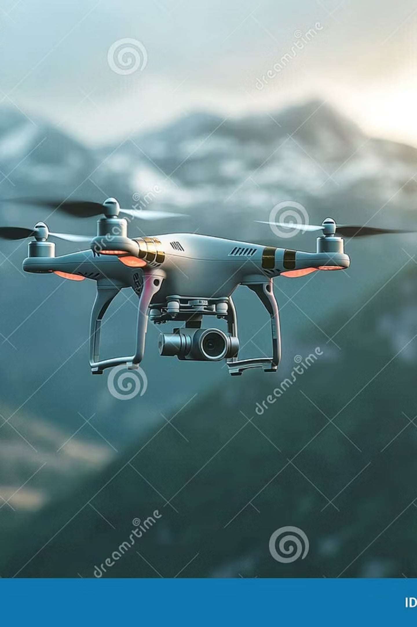
Drone-Based 3D Mapping: From Pixels to Terrain
A concise guide explaining how image formation, binocular vision, and multi-view geometry combine to turn drone photos into accurate 3D terrain models.

Slide 2

Introduction: The Digital Twin Revolution
Drone mapping converts many 2D aerial images into a precise 3D digital twin of the landscape. This transformation reverses the image formation process: instead of projecting 3D scenes to 2D photos, we estimate the 3D scene that produced those photos. The pipeline blends photogrammetry, geometry, flight planning, and optimization to create terrain models used in surveying, construction, agriculture, and environmental monitoring.

Slide 3
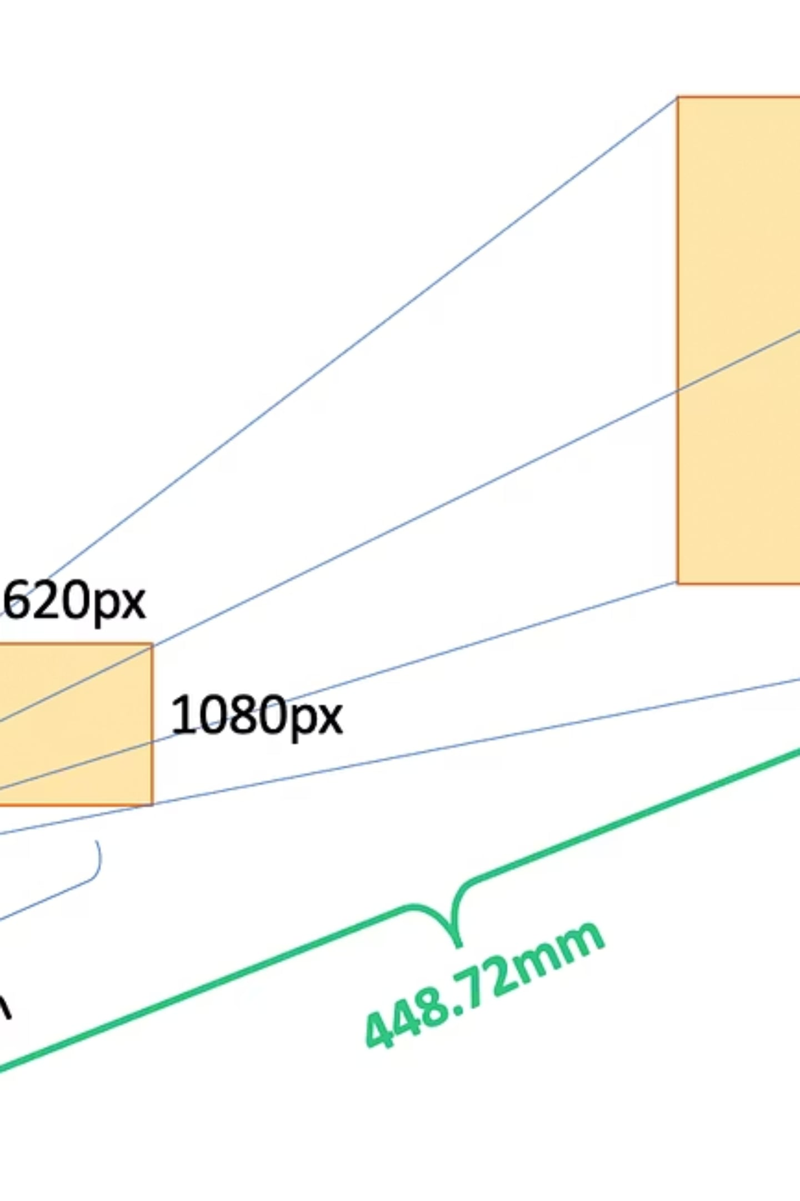
Image Formation: How Cameras See the World
Cameras approximate a pinhole projection: a 3D world point maps to a 2D image point via perspective projection. Key camera parameters govern this mapping — focal length, principal point, lens distortion, and sensor geometry — and must be modeled or calibrated. Because a single photo flattens depth, objects at different heights shift (relief displacement). That ambiguity is resolved by combining multiple images taken from different viewpoints.

Slide 4

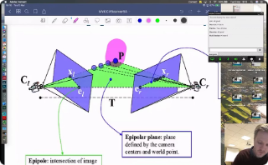
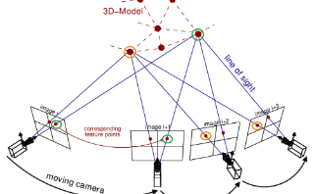
Binocular Vision: Depth from Two Views
Core idea
Epipolar geometry
Triangulation & accuracy
Binocular vision uses two images of the same scene to recover depth by triangulation. Corresponding points in the image pair define rays that intersect in 3D space, giving the 3D location of the scene point.
Epipolar constraints reduce the search for correspondences: a point in one image must lie along its epipolar line in the other image. This dramatically speeds and stabilizes matching.
Triangulation accuracy improves with baseline (distance between cameras) and image resolution, but wide baselines increase occlusions and matching difficulty. Practical systems balance baseline, overlap, and viewpoints.

Slide 5
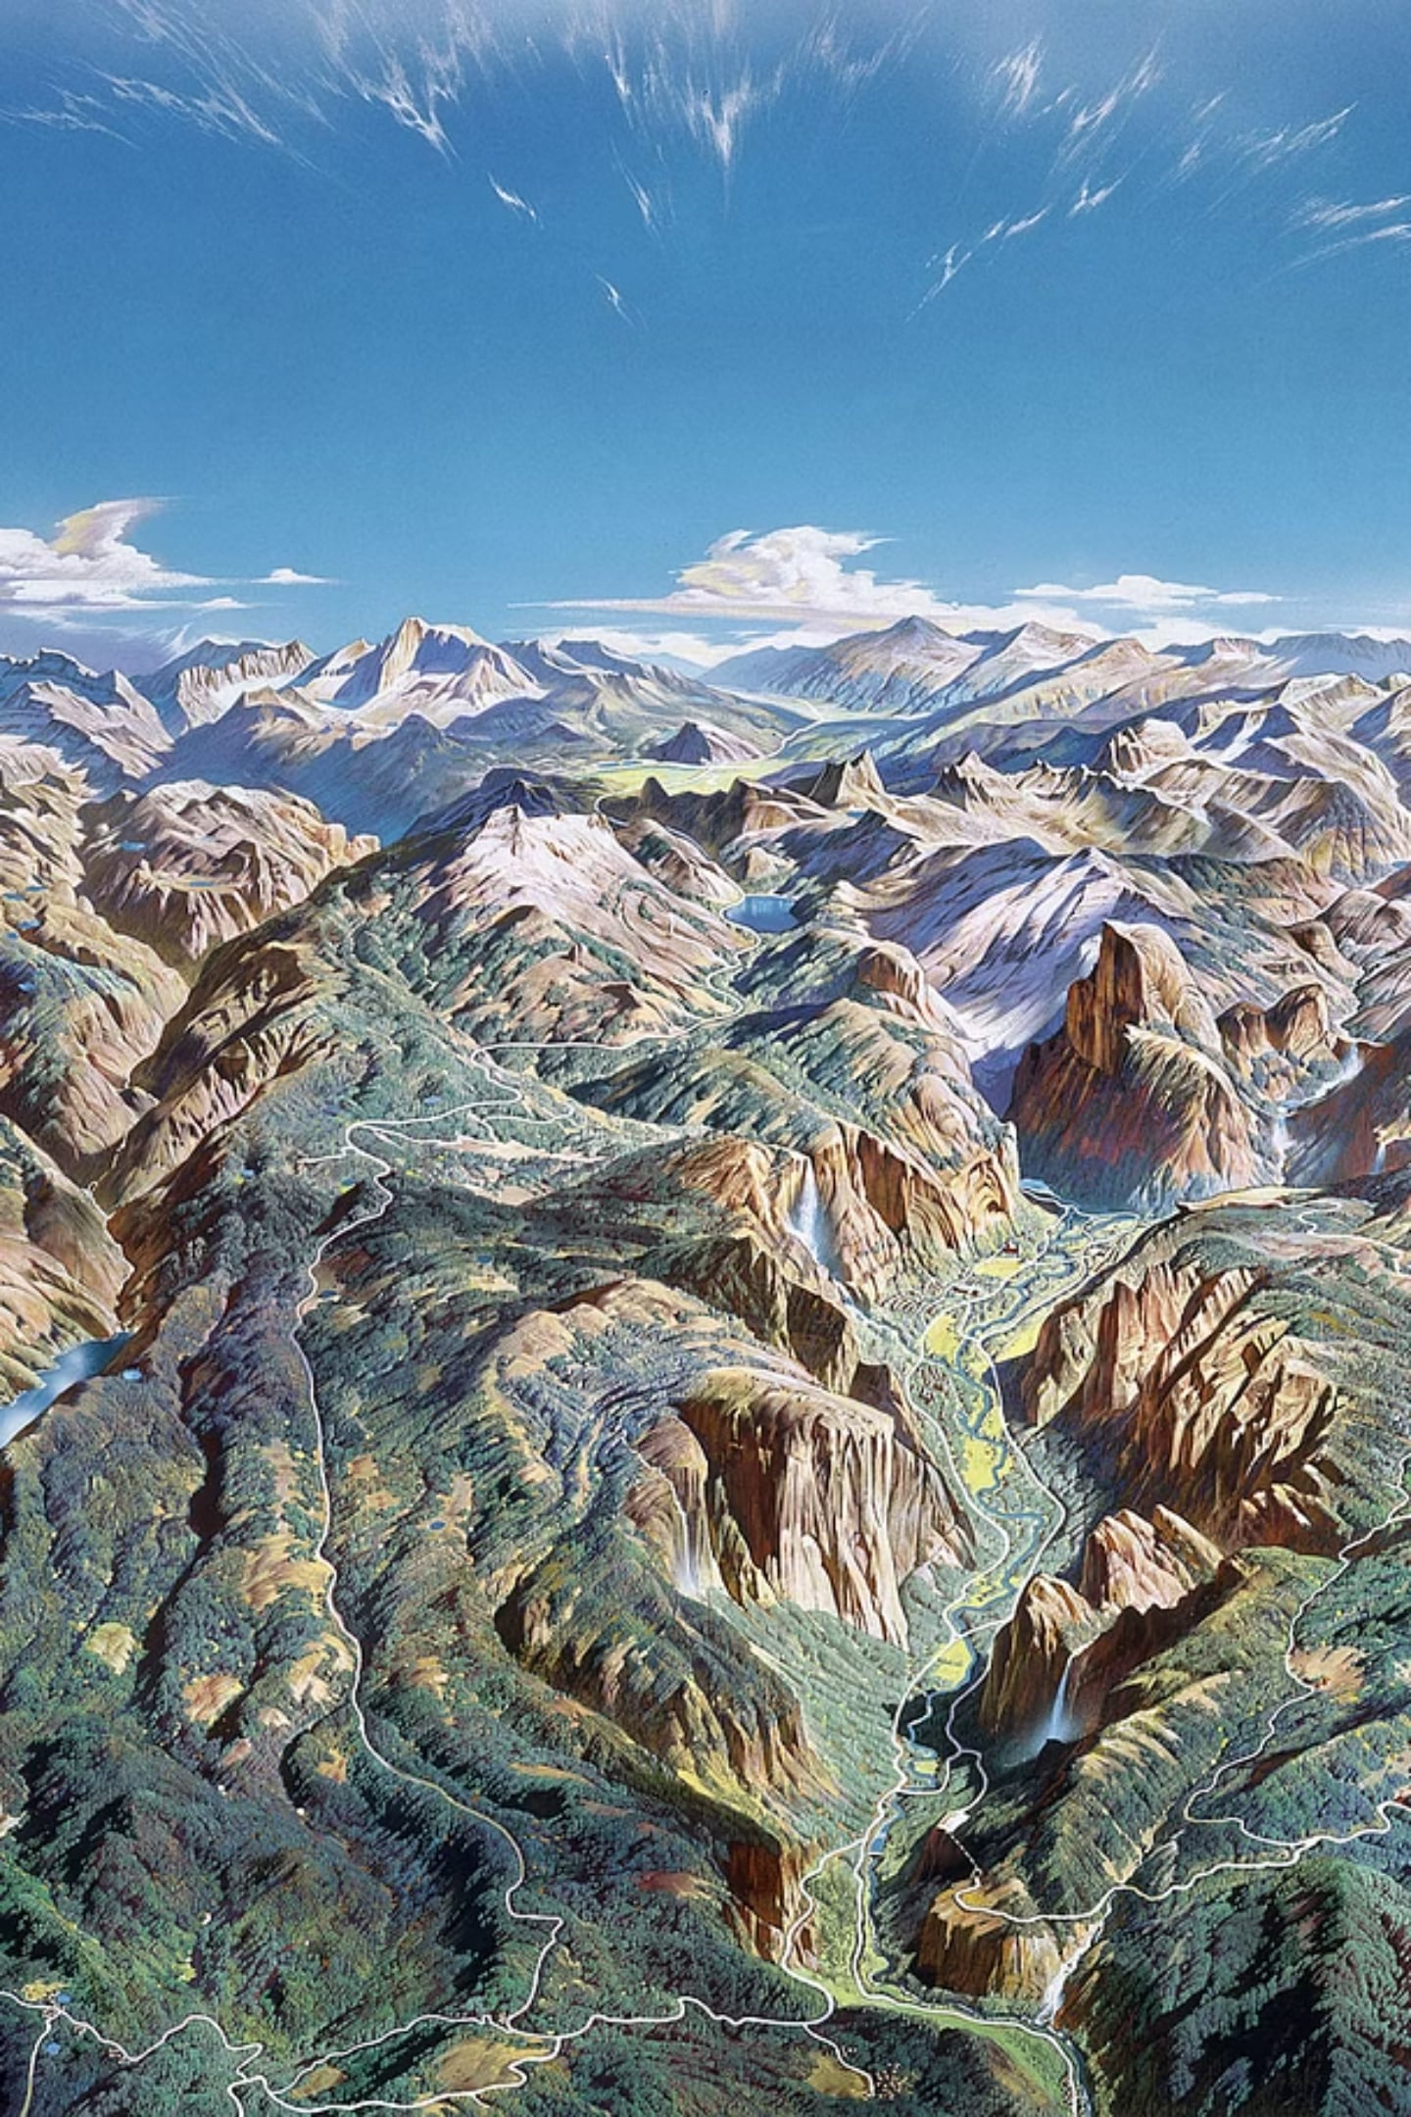
Multi-View Geometry: From Pairs to Whole Scenes
Multi-view geometry scales binocular principles across dozens to thousands of images. Feature matching across many views produces a sparse 3D point cloud and camera poses. Bundle adjustment jointly refines all camera parameters and 3D points by minimizing reprojection error — the core optimization that yields coherent, metrically accurate reconstructions. Using many views resolves occlusions, increases surface coverage, and improves detail through redundant observations.

Slide 6
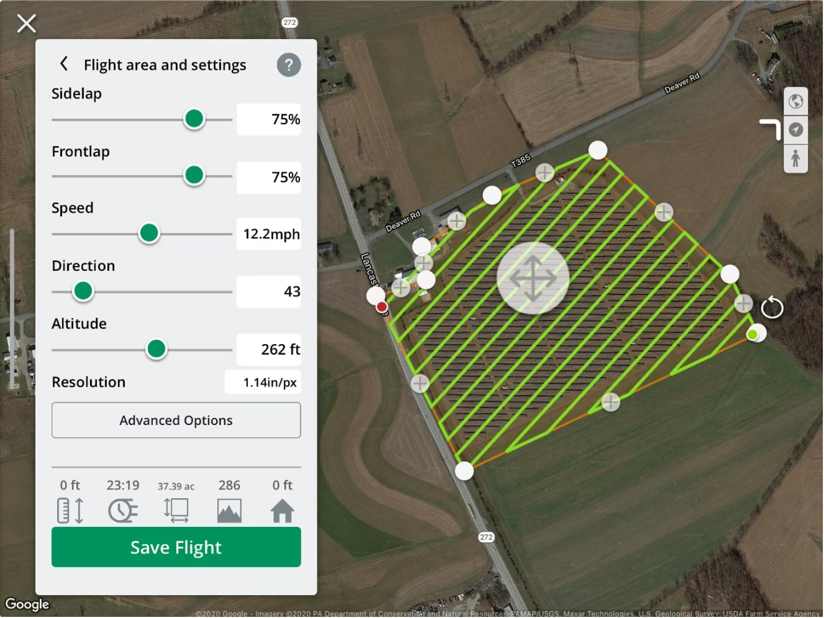
Drone Acquisition: Practical Flight Strategies
Key acquisition practices
High overlap: ~75% front overlap and ~70% side overlap ensures each ground point appears in multiple frames.
Varying viewing angles: oblique and nadir images reduce relief displacement and capture vertical structures.
Ground Control Points (GCPs): surveyed coordinates anchor the model to real-world scale and correct drift.
Consistent exposure and time-synced cameras simplify matching and radiometric stitching.

Slide 7

Processing Pipeline: From Images to Terrain
Typical processing steps: feature detection (SIFT/ORB), feature matching across images, initial pose estimation (structure-from-motion), bundle adjustment refinement, dense stereo matching to produce a dense point cloud, mesh generation to form surfaces, and texture/orthomosaic creation for visual accuracy. Depth-map fusion merges per-view depth into a consistent surface that captures terrain and structural detail.

Slide 8

Advances: Learning-Based Planning & Reconstruction
Modern research applies deep learning to two bottlenecks: predicting which viewpoints will yield reliable 3D reconstructions ("reconstructability") and improving dense stereo/depth estimation under challenging lighting or textureless surfaces. Learning-based planners can propose flight paths that maximize coverage and reconstruction quality while minimizing flight time and battery consumption. Neural depth fusion and learned priors help fill gaps where photogrammetry struggles (e.g., glass, water).
There was an error generating this image

Slide 9
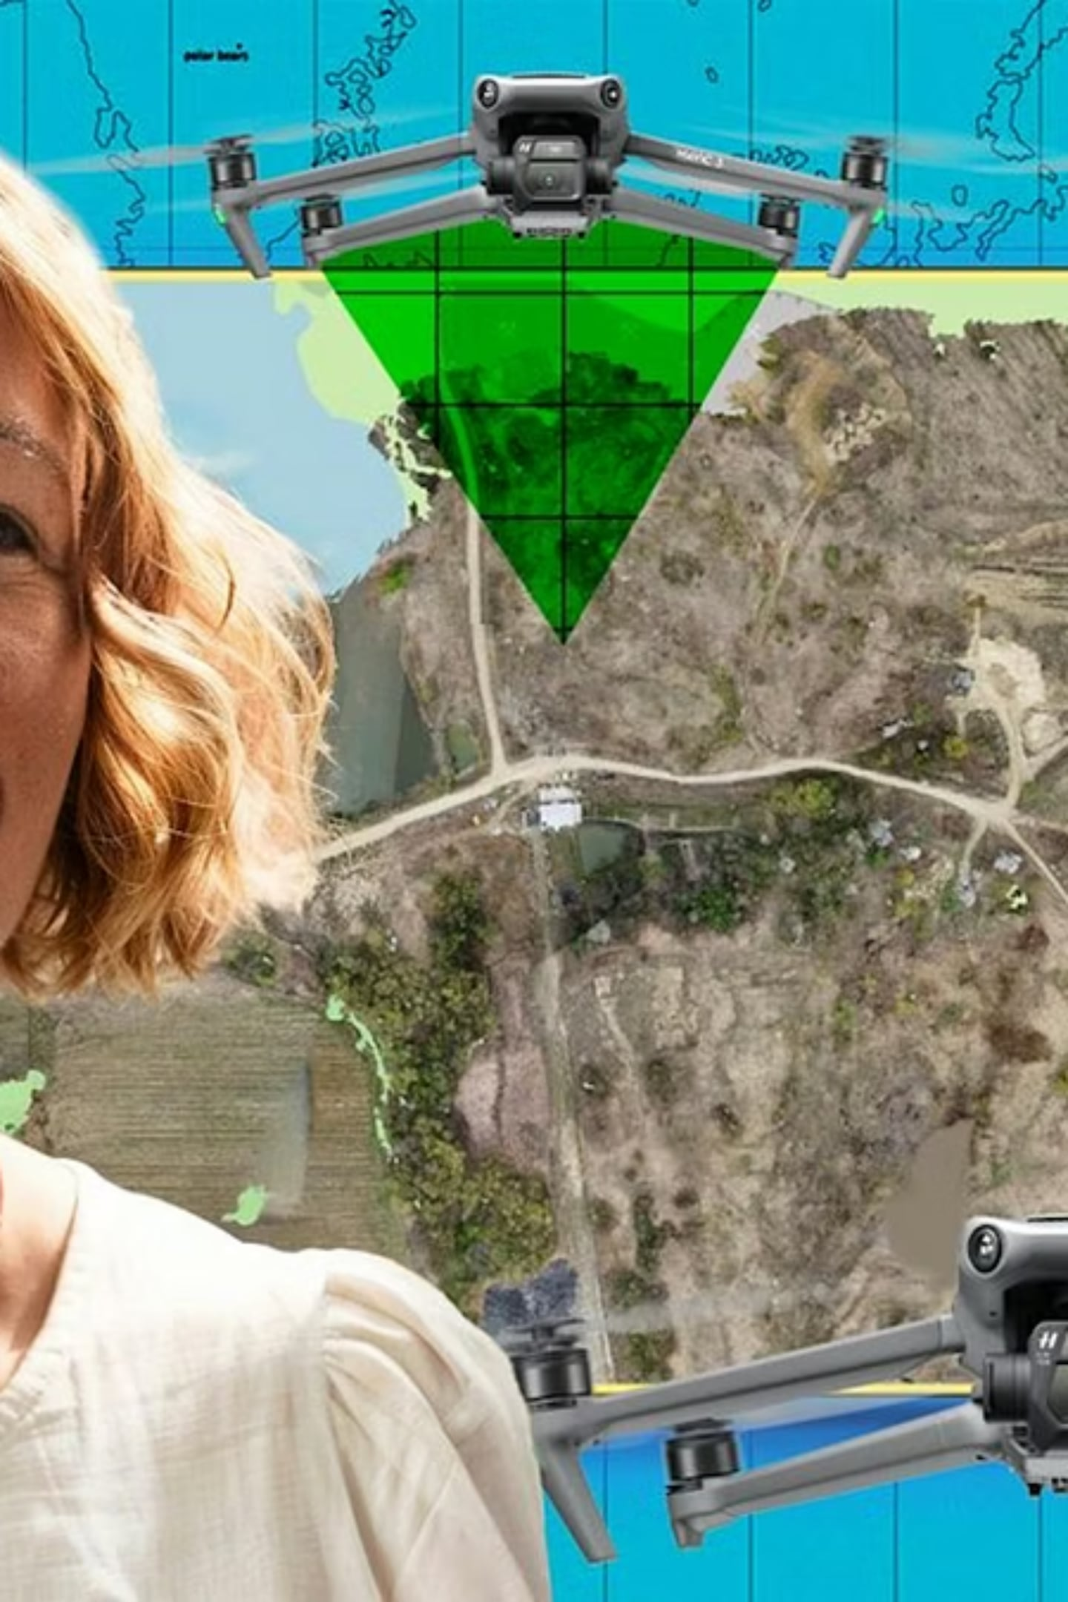
Future Outlook & Practical Considerations
Expect tighter integration of real-time reconstruction onboard drones, automated GCP alternatives (RTK/PPK GNSS), and smarter planners that adapt mid-flight. Practical deployments must still address regulatory flight limits, variable lighting, reflective surfaces, and terrain with limited texture. Combining LiDAR with imagery is a growing hybrid approach for complex scenes.

Slide 10
Conclusion & References
Conclusion: Drone-based 3D mapping depends on accurate models of image formation, the depth cues provided by binocular vision, and the scalability of multi-view geometry. Well-planned acquisition and robust processing pipelines convert overlapping images into precise, actionable terrain models.
Selected references (Google Scholar)
Hartley, R., & Zisserman, A. (2004). Multiple View Geometry in Computer Vision. Cambridge University Press.
Ma, Y., Soatto, S., Kosecka, J., & Sastry, S. S. (2004). An Invitation to 3-D Vision: From Images to Geometric Models. Springer. (originally 2003/2004 editions)
F. Remondino & S. El-Hakim (2006). Image-based 3D modelling: A review. The Photogrammetric Record.
S. Agarwal et al. (2011). Building Rome in a Day. Communications of the ACM (example multi-view SfM scaling paper).
For deeper reading, search each title on Google Scholar for the original papers and newer works building on these foundations.

